Slide 1

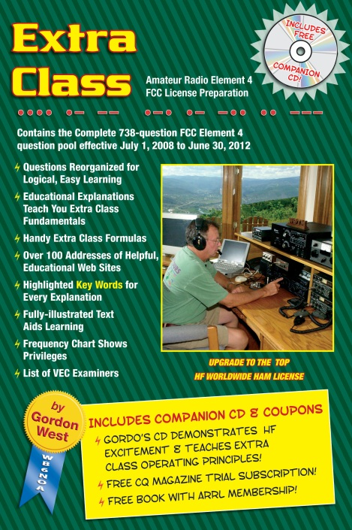
Amateur Extra Licensing Class
Outer Space Comms
Presented by
W5YI
Arlington, Texas

Slide 2
Amateur Radio Extra Class
Element 4 Course Presentation
ELEMENT 4 Groupings
  Rules & Regs
  Skywaves & Contesting
  Outer Space Comms
  Visuals & Video Modes
  Digital Excitement with Computers & Radios
  Modulate Your Transmitters
  Amps & Power Supplies
  Receivers with Great Filters

Slide 3
Amateur Radio Extra Class
Element 4 Course Presentation
ELEMENT 4 Groupings
  Oscillate & Synthesize This!
  Circuits & Resonance for All!
  Components in Your New Rig
  Logically Speaking of Counters
  Optos & OpAmps Plus Solar
  Test Gear, Testing, Testing 1,2,3
  Antennas
  Feedlines & Safety

Slide 4
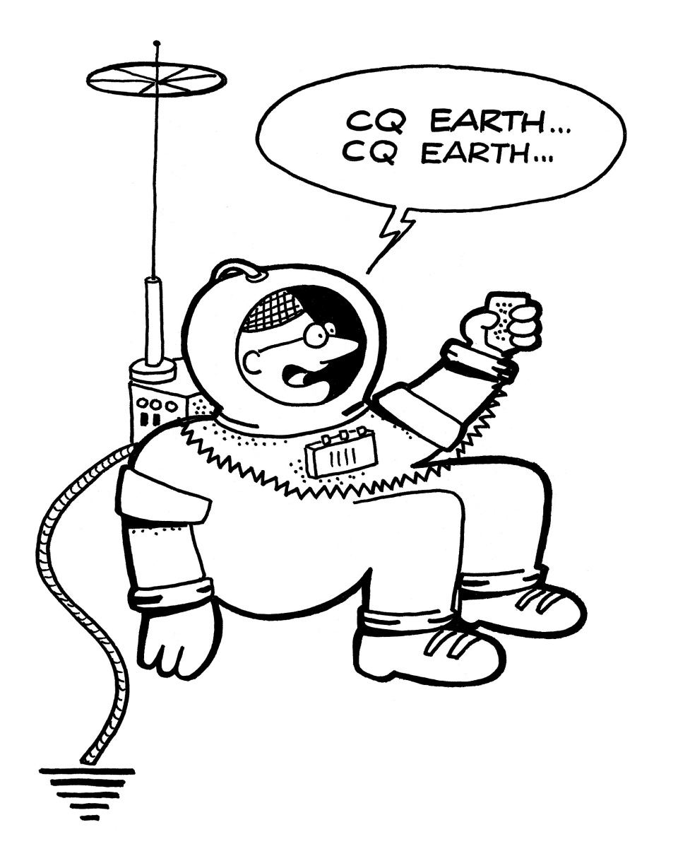
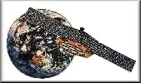
Amateur Radio Extra Class
Outer Space Comms
E1D02 The amateur-satellite service is a radio communications service using amateur stations on satellites.

Slide 5
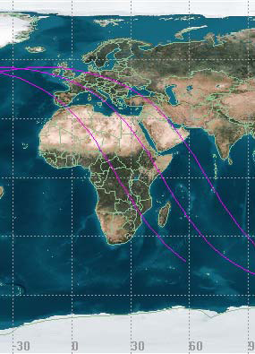
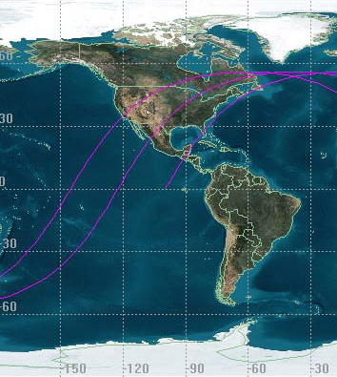
Amateur Radio Extra Class
Outer Space Comms
E2A02… The direction of a descending pass for an amateur satellite is from north to south.
E2A01… The direction of an ascending pass for an amateur satellite is from south to north.
Ascending and descending are defined for a satellite’s motion referenced to the equator. Only the north or south motion is important and not the east-west motion. If the satellite is moving from south to north, then it makes an ascending pass and if it moves north-to-south it is descending.

Slide 6
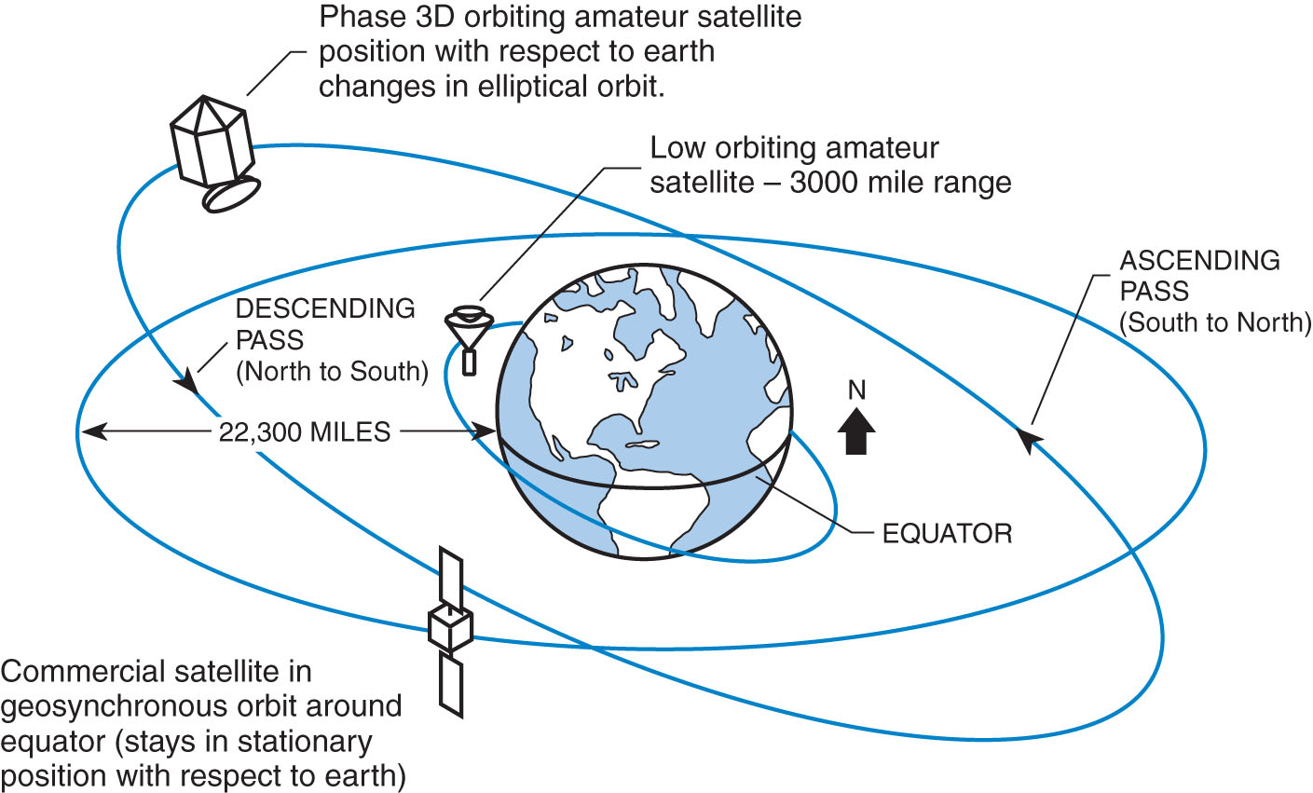
Amateur Radio Extra Class
Outer Space Comms
E2A03… The time it takes for a satellite to complete one revolution around the earth is the orbital period of that satellite.

Slide 7
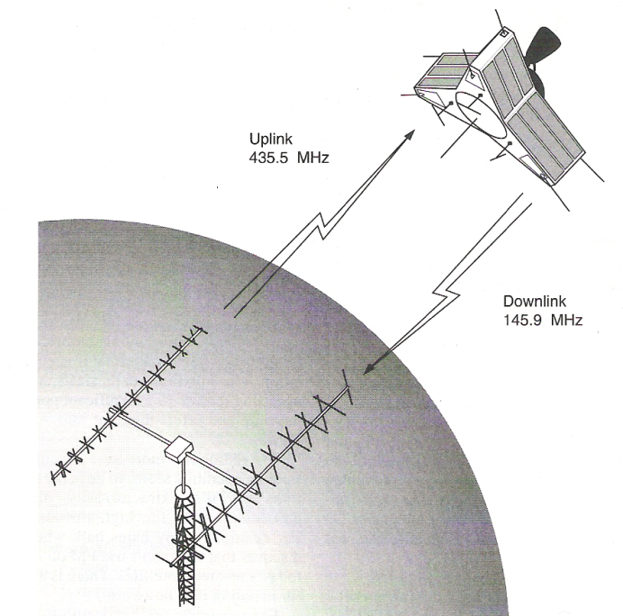
Amateur Radio Extra Class
Outer Space Comms
E1D04… An earth station in the amateur satellite service is an amateur station within 50 km of the earth's surface for communications with amateur stations in space.
E1D11… Any amateur station, subject to the privileges of the class of operator license held by the control operator, is eligible to operate earth stations.

Slide 8
Amateur Radio Extra Class
Outer Space Comms
E1D03… A telecommand station in the amateur satellite service is an amateur station that transmits communications to initiate, modify or terminate certain functions of a space station.
E1D01… The definition of the term telemetry is one-way transmission of measurements at a distance from the measuring instrument.
E1D10… Any amateur stations so designated by the space station licensee are eligible to be telecommand stations.
Telemetry is a technology that allows the remote measurement and reporting of information of interest to the system designer or operator. Systems that need instructions and data sent to them in order to operate require the counterpart of telemetry, telecommand.

Slide 9
Amateur Radio Extra Class
Outer Space Comms
E2A04… The term “mode” as applied to an amateur radio satellite refers to the satellite's uplink and downlink frequency bands.
E2A05… The letters in a satellite's mode designator specify the uplink and downlink frequencies.
Frequency Bands Frequency Range Modes
High Frequency 21 – 30 MHz Mode H
VHF 144 – 146 MHz Mode V
UHF 435 – 438 MHz Mode U
L band 1.26-1.27 GHz Mode L
S band 2.4-2.45 GHz Mode S
C band 5.8 GHz Mode C
X band 10.4 GHz Mode X
K band 24 GHz Mode K
Amateur transmit and receive frequencies for satellite operation are on separate bands. Each band has its own designator.

Slide 10
Amateur Radio Extra Class
Outer Space Comms
E2A09… The terms L band and S band specify the 23 centimeter and 13 centimeter bands with regard to satellite communications.
E2A06… A satellite operating in the U/V mode would receive signals in the 432 MHz band.
Wave Guide Band Designator | Frequency Range
L | ~ 1 GHz to 2 GHz
S | ~2 GHz to 4 GHz
G | 3.95 GHz to 5.85 GHz
C | 4.9 GHz to 7.o5 GHz
H | 7.05 GHz to 10 GHz
X | 8.2 GHZ to 12.4 GHz
KU | 12.4 GHz to 18 GHz
K | 18 GHz to 26.5 GHz
KA | 26.5 GHz to 40 GHz

Slide 11
Amateur Radio Extra Class
Outer Space Comms
E2A07… A linear transponder can relay FM, CW, SSB, SSTV, PSK and Packet signals.
E2A10… The received signal from an amateur satellite may exhibit a rapidly repeating fading effect because the satellite is rotating.
E2A11… A circularly polarized antenna can be used to minimize the effects of spin modulation and Faraday rotation.
Satellite designers often spin the satellite to improve its pointing stability so a rapid fading effect can be due to satellite rotation.
A magneto-optic effect, also known as the Faraday effect, in which the plane of polarization of an electromagnetic wave is rotated under the influence of a magnetic field parallel to the direction of propagation. It is named after the English physicist Michael Faraday (1791-1867), who first observed the effect in 1845.

Slide 12
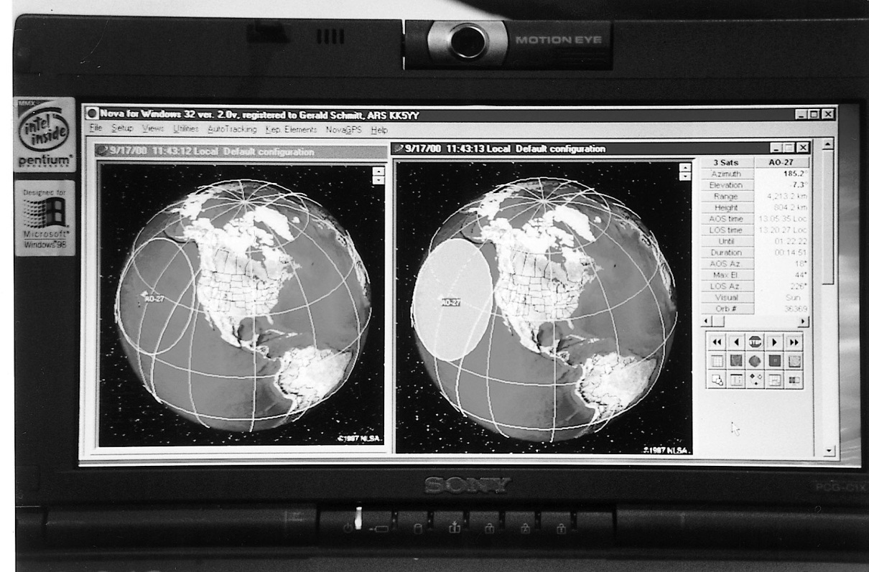
Amateur Radio Extra Class
Outer Space Comms
E2A12… By calculations using the Keplerian elements for the specified satellite you can predict the location of a satellite at a given time.
Computer programs and websites can show you where and when an amateur satellite or the Space Station will be in range of your ham station.

Slide 13
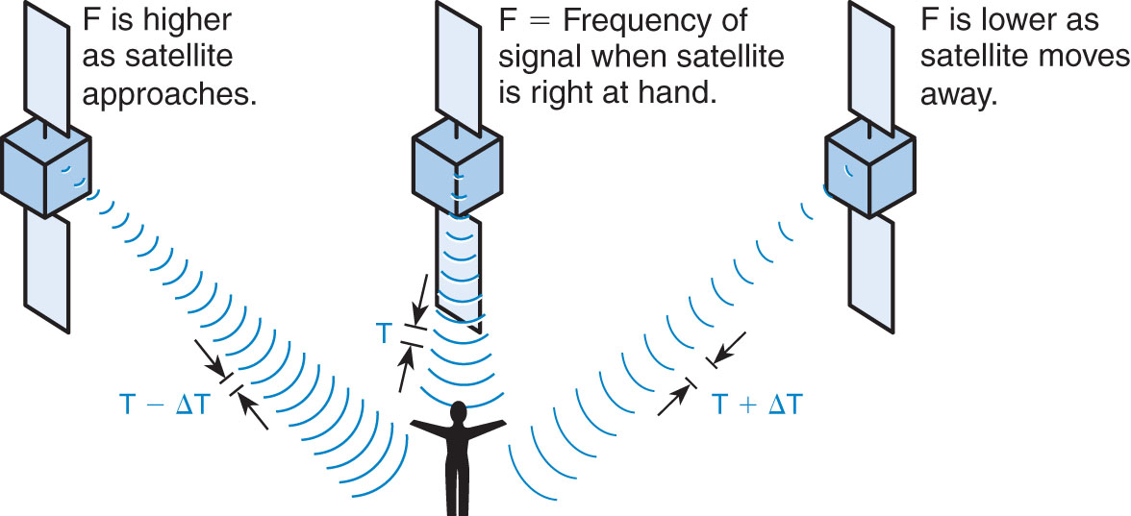
Amateur Radio Extra Class
Outer Space Comms
E2A14… A satellite's transmitted signal frequency shifts lower as the satellite passes overhead due to the Doppler Effect.
When the satellite is approaching the receiving station its transmitted frequency is higher and when going away from the receiving station its frequency will be lower. Like a train whistle you hear as a train approaches you and passes away from you. This effect is more pronounced at the higher frequencies.

Slide 14
Amateur Radio Extra Class
Outer Space Comms
E2A08… The primary reason for satellite users to limit their transmit ERP is because the satellite transmitter output power is limited and using a lower power allows more users to use the transmitter (using the minimum power necessary for communication is the rule).
E2D04… The purpose of digital store-and-forward functions on an amateur satellite is to store digital messages in the satellite for later download by other stations.
Like a post office box you can send a message to and the
recipient will go to that mailbox to retrieve your message.
E2D05… The Store-and-Forward technique is normally used by low-earth orbiting digital satellites to relay messages around the world (beyond the footprint of the satellite when you send your message).
E2A13… Geosynchronous satellites appear to stay in one (fixed) position in the sky.

Slide 15
Amateur Radio Extra Class
Outer Space Comms
E1D12… The FCC’s International Bureau, Washington, DC must be notified before launching an amateur space station.
E1D06… An amateur space station must incorporate the capability of effecting a cessation of transmissions by telecommand when so ordered by the FCC in order to comply with FCC amateur service space station requirements.
E1D07… The 40m, 20m, 17m, 15m, 12m and10m bands amateur service have frequencies authorized for space stations.
E1D05… A holder of any class amateur licensee is authorized to be the control operator of a space station.

Slide 16
Amateur Radio Extra Class
Outer Space Comms
E1D08… The 2 meter VHF amateur service band has frequencies available for space stations.
    The 6 meter and 1.25 meter bands do not have frequencies
    available for space stations.
E1D09… The 70 cm, 23 cm, 12 cm amateur service UHF bands have frequencies available for a space stations.
E3A01… The approximate maximum separation along the surface of the Earth between two stations communicating by moonbounce is 12,000 miles, as long as both can “see” the moon.

Slide 17
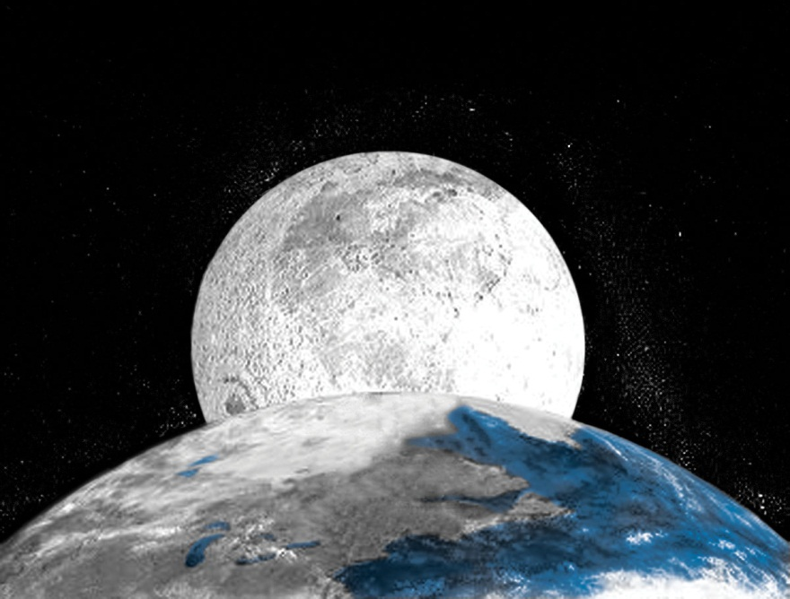
Amateur Radio Extra Class
Outer Space Comms
E3A04… A receiving system with very low noise figure is desirable for EME communications. (EME – Earth-Moon-Earth)
Around 0.25 dB noise figure for VHF and UHF is desired.

Slide 18
Amateur Radio Extra Class
Outer Space Comms
E3A07… The 144.000 - 144.100 MHz frequency range is where you would you normally tune to find EME stations in the two meter band
E3A05… Two-minute transmit and receive sequences, where one station transmits for a full two minutes and then receives for the following two minutes is normally used on 144 MHz band when attempting an EME contact.
E3A08… The 432.000 - 432.100 MHz frequency range is where you would you normally tune to find EME stations in the 70 cm band.

Slide 19
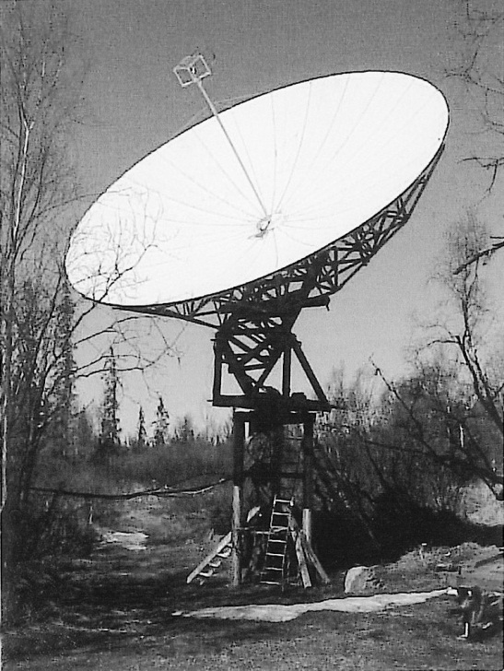
Amateur Radio Extra Class
Outer Space Comms
E3A06… Two and one half minute time sequences, where one station transmits for a full 2.5 minutes and then receives for the following 2.5 minutes, are normally used on 432 MHz band when attempting an EME contact.
E3A02… A fluttery irregular fading signal characterizes libration fading of an earth-moon-earth signal.
E3A03… Scheduling EME when the moon is at perigee will generally result in the least path loss.

Slide 20
Element 4 Extra Class
Question Pool
Outer Space Comms
Valid July 1, 2008
Through
June 30, 2012

Slide 21
E1D02 What is the amateur-satellite service?
A radio navigation service using satellites for the purpose of self-training, intercommunication and technical studies carried out by amateurs
A spacecraft launching service for amateur-built satellites
A radio communications service using amateur stations on satellites
A radio communications service using stations on Earth satellites for weather information gathering

Slide 22
E2A02 What is the direction of a descending pass for an amateur satellite?
From north to south
From west to east
From east to west
From south to north

Slide 23
E2A01 What is the direction of an ascending pass for an amateur satellite?
From west to east
From east to west
From south to north
From north to south

Slide 24
E2A03 What is the orbital period of a satellite?
The point of maximum height of a satellite's orbit
The point of minimum height of a satellite's orbit
The time it takes for a satellite to complete one revolution around the Earth
The time it takes for a satellite to travel from perigee to apogee

Slide 25
E1D04 What is an Earth station in the amateur satellite service?
An amateur station within 50 km of the Earth's surface for communications with amateur stations by means of objects in space
An amateur station that is not able to communicate using amateur satellites
An amateur station that transmits telemetry consisting of measurement of upper atmosphere data from space
Any amateur station on the surface of the Earth

Slide 26
E1D11 Which amateur stations are eligible to operate as Earth stations?
Any amateur station whose licensee has filed a pre-space notification with the FCC’s International Bureau
Only those of General, Advanced or Amateur Extra Class operators
Only those of Amateur Extra Class operators
Any amateur station, subject to the privileges of the class of operator license held by the control operator

Slide 27
E1D03 What is a telecommand station in the amateur satellite service?
An amateur station located on the Earth’s surface for communications with other Earth stations by means of Earth satellites
An amateur station that transmits communications to initiate, modify or terminate certain functions of a space station
An amateur station located more than 50 km above the Earth’s surface
An amateur station that transmits telemetry consisting of measurements of upper atmosphere data from space

Slide 28
E1D01 What is the definition of the term telemetry?
One-way transmission of measurements at a distance from the measuring instrument
A two-way interactive transmission
A two-way single channel transmission of data
One-way transmission that initiates, modifies, or terminates the functions of a device at a distance

Slide 29
E1D10 Which amateur stations are eligible to be telecommand stations?
Any amateur station designated by NASA
Any amateur station so designated by the space station licensee
Any amateur station so designated by the ITU
All of these choices are correct

Slide 30
E2A04 What is meant by the term “mode” as applied to an amateur radio satellite?
The type of signals that can be relayed through the satellite
The satellite's uplink and downlink frequency bands
The satellite's orientation with respect to the Earth
Whether the satellite is in a polar or equatorial orbit

Slide 31
E2A05 What do the letters in a satellite's mode designator specify?
Power limits for uplink and downlink transmissions
The location of the ground control station
The polarization of uplink and downlink signals
The uplink and downlink frequencies

Slide 32
E2A09 What do the terms L band and S band specify with regard to satellite communications?
The 23 centimeter and 13 centimeter bands
The 2 meter and 70 centimeter bands
FM and Digital Store-and-Forward systems
Which sideband to use

Slide 33
E2A06 On what band would a satellite receive signals if it were operating in mode U/V?
432 MHz
144 MHz
50 MHz
28 MHz

Slide 34
E2A07 Which of the following types of signals can be relayed through a linear transponder?
FM and CW
SSB and SSTV
PSK and Packet
All these answers are correct

Slide 35
E2A10 Why may the received signal from an amateur satellite exhibit a rapidly repeating fading effect?
Because the satellite is rotating
Because of ionospheric absorption
Because of the satellite's low orbital altitude
Because of the Doppler effect

Slide 36
E2A11 What type of antenna can be used to minimize the effects of spin modulation and Faraday rotation?
A linearly polarized antenna
A circularly polarized antenna
An isotropic antenna
A log-periodic dipole array

Slide 37
E2A12 What is one way to predict the location of a satellite at a given time?
By means of the Doppler data for the specified satellite
By subtracting the mean anomaly from the orbital inclination
By adding the mean anomaly to the orbital inclination
By calculations using the Keplerian elements for the specified satellite

Slide 38
E2A14 What happens to a satellite's transmitted signal due to the Doppler Effect?
The signal strength is reduced as the satellite passes overhead
The signal frequency shifts lower as the satellite passes overhead
The signal frequency shifts higher as the satellite passes overhead
The polarization of the signal continually rotates

Slide 39
E2A08 What is the primary reason for satellite users to limit their transmit ERP?
For RF exposure safety
Because the satellite transmitter output power is limited
To avoid limiting the signal of the other users
To avoid interfering with terrestrial QSOs

Slide 40
E2D04 What is the purpose of digital store-and-forward functions on an Amateur satellite?
To upload operational software for the transponder
To delay download of telemetry until the satellite is over the control station
To store digital messages in the satellite for later download by other stations
To relay messages between satellites

Slide 41
E2D05 Which of the following techniques is normally used by low-earth orbiting digital satellites to relay messages around the world?
Digipeating
Store-and-forward
Multi-satellite relaying
Node hopping

Slide 42
E2A13 What type of satellite appears to stay in one position in the sky?
HEO
Geosynchronous
Geomagnetic
LEO

Slide 43
E1D12 Who must be notified before launching an amateur space station?
The National Aeronautics and Space Administration, Houston, TX
The FCC’s International Bureau, Washington, DC
The Amateur Satellite Corp., Washington, DC
All of these answers are correct

Slide 44
E1D06 Which of the following special provisions must a space station incorporate in order to comply with space station requirements?
The space station must be capable of effecting a cessation of transmissions by telecommand when so ordered by the FCC
The space station must cease all transmissions after 5 years
The space station must be capable of changing its orbit whenever such a change is ordered by NASA
The station call sign must appear on all sides of the spacecraft

Slide 45
E1D07 Which amateur service HF bands have frequencies authorized to space stations?
Only 40m, 20m, 17m, 15m, 12m and 10m
Only 40m, 20m, 17m, 15m and 10m bands
40m, 30m, 20m, 15m, 12m and 10m bands
All HF bands

Slide 46
E1D05 What class of licensee is authorized to be the control operator of a space station?
Any except those of Technician Class operators
Only those of General, Advanced or Amateur Extra Class operators
A holder of any class of license
Only those of Amateur Extra Class operators

Slide 47
E1D08 Which VHF amateur service bands have frequencies available for space stations?
6 meters and 2 meters
6 meters, 2 meters, and 1.25 meters
2 meters and 1.25 meters
2 meters

Slide 48
E1D09 Which amateur service UHF bands have frequencies available for a space station?
70 cm
70 cm, 23 cm, 13 cm
70 cm and 33 cm
33 cm and 13 cm

Slide 49
E3A01 What is the approximate maximum separation along the surface of the Earth between two stations communicating by moonbounce?
500 miles if the moon is at perigee
2000 miles, if the moon is at apogee
5000 miles, if the moon is at perigee
12,000 miles, as long as both can “see” the moon

Slide 50
E3A04 What type of receiving system is desirable for EME communications?
Equipment with very wide bandwidth
Equipment with very low dynamic range
Equipment with very low gain
Equipment with very low noise figures

Slide 51
E3A07 What frequency range would you normally tune to find EME stations in the 2 meter band?
144.000 - 144.001 MHz
144.000 - 144.100 MHz
144.100 - 144.300 MHz
145.000 - 145.100 MHz

Slide 52
E3A05 What transmit and receive time sequencing is normally used on 144 MHz when attempting an EME contact?
Two-minute sequences, where one station transmits for a full two minutes and then receives for the following two minutes
One-minute sequences, where one station transmits for one minute and then receives for the following one minute
Two-and-one-half minute sequences, where one station transmits for a full 2.5 minutes and then receives for the following 2.5 minutes
Five-minute sequences, where one station transmits for five minutes and then receives for the following five minutes

Slide 53
E3A08 What frequency range would you normally tune to find EME stations in the 70 cm band?
430.000 - 430.150 MHz
430.100 - 431.100 MHz
431.100 - 431.200 MHz
432.000 - 432.100 MHz

Slide 54
E3A06 What transmit and receive time sequencing is normally used on 432 MHz when attempting an EME contact?
Two-minute sequences, where one station transmits for a full two minutes and then receives for the following two minutes
One-minute sequences, where one station transmits for one minute and then receives for the following one minute
Two-and-one-half minute sequences, where one station transmits for a full 2.5 minutes and then receives for the following 2.5 minutes
Five-minute sequences, where one station transmits for five minutes and then receives for the following five minutes

Slide 55
E3A02 What characterizes libration fading of an earth-moon-earth signal?
A slow change in the pitch of the CW signal
A fluttery irregular fading
A gradual loss of signal as the sun rises
The returning echo is several Hertz lower in frequency than the transmitted signal

Slide 56
E3A03 When scheduling EME contacts, which of these conditions will generally result in the least path loss?
When the moon is at perigee
When the moon is full
When the moon is at apogee
When the MUF is above 30 MHz

